Slide 1
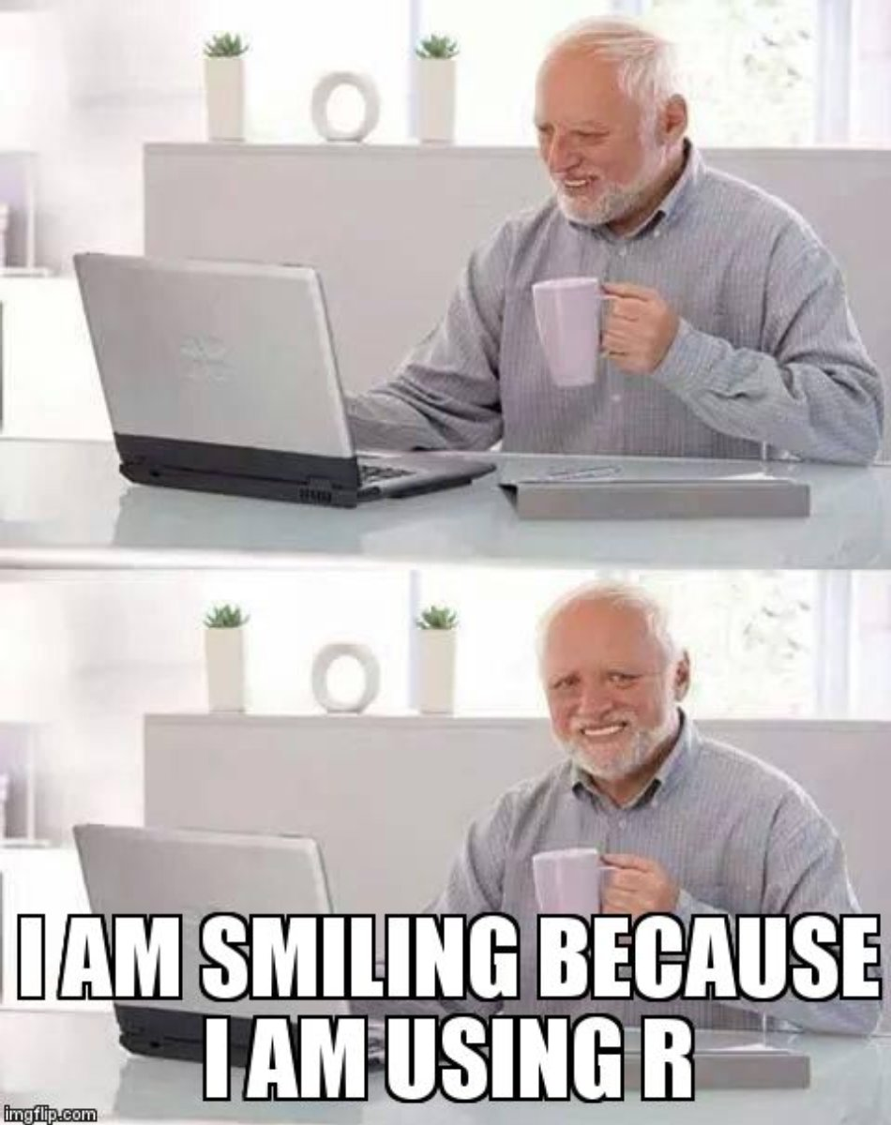
MES 503 Lab 1
Kayla Blincow, PhD

Slide 2
Repeat after me…
I am a student.
I am still learning and that is okay.
My background is different than everyone else’s, therefore it makes no sense to compare my abilities or progress to anybody else.
Notes:
This is a safe space. To get the most out of this course, you

Slide 3
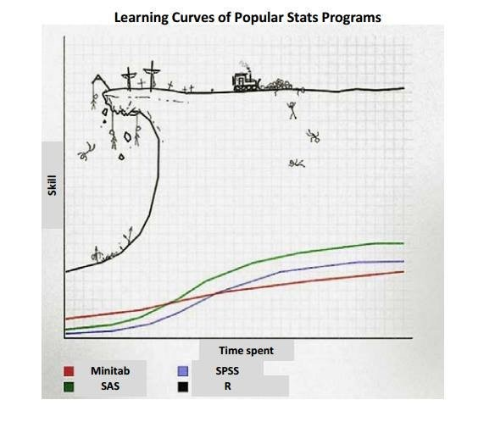
My Philosophy on Coding
In this class, we are a team
Don’t be afraid to say I don’t know
You will almost never code without the internet to help you
Use Google!
Use ChatGPT (but carefully)
Use each other
Coding is a language; the best way to learn it is to use it.
Notes:
Everyone will get the most out of this class if we shed whatever insecurities you might have about saying you are lost or don’t know what’s happening. It’s okay to not know. Nobody is going to be upset.
I have been coding a long time and sometimes I skim over steps because I forget what it’s like to be new. STOP ME! Be like woah, Kayla, what just happened?? I will not be upset. I want to help you get better at this. I also sometimes just talk fast—I will try to slow down.

Slide 4
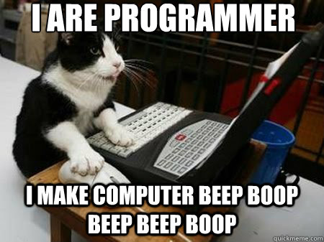
Typical Lab Structure
Materials shared on Brightspace
~ 1 hour analysis topic
~ 1 hour pure coding skills
Exercise combining the two
Notes:
You’re responsible for keeping things organized

Slide 5
What we are doing this week!

Slide 6

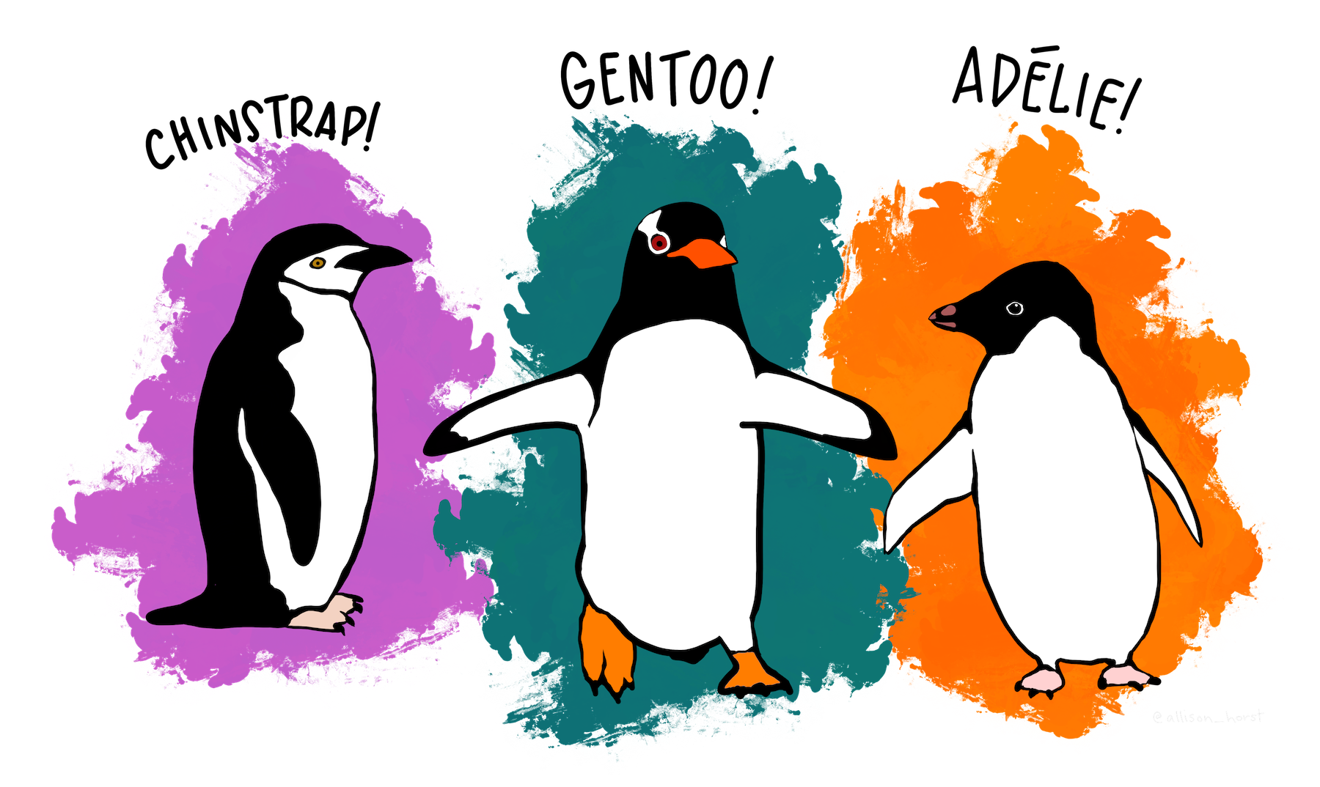
Palmer Penguins (the R queens’ alternative to the iris and cars datasets, shout out to Allison Horst and co.)
Horst AM, Hill AP, Gorman KB (2020). palmerpenguins: Palmer #> Archipelago (Antarctica) penguin data. R package version 0.1.0. #> https://allisonhorst.github.io/palmerpenguins/. doi: #> 10.5281/zenodo.3960218.

Slide 7
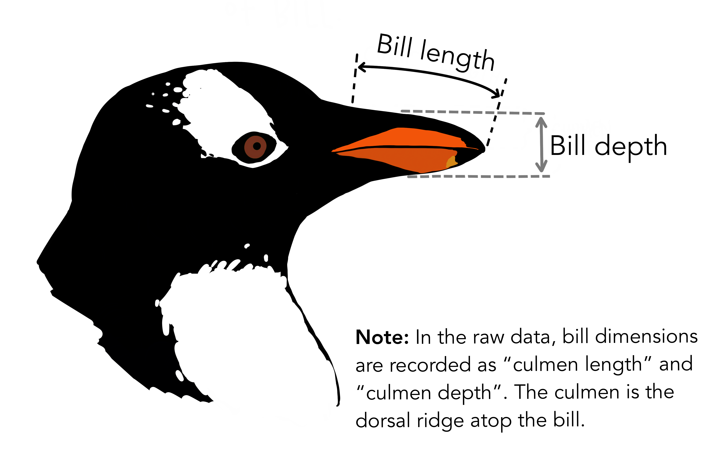

Slide 8
Switch to ze code!
Notes:
R Projects

